Slide 1









Whiteboardmaths.com
7
2
1
5
© 2008 All rights reserved

Slide 2
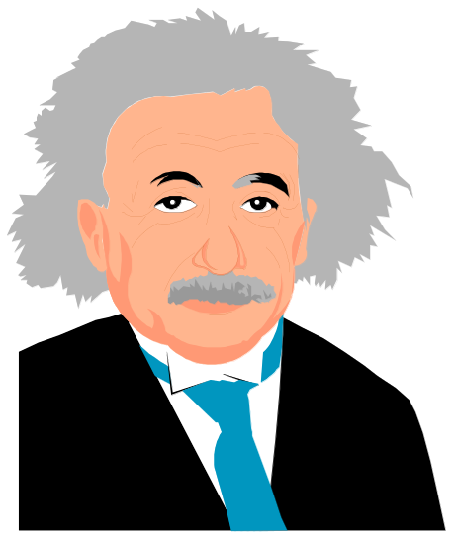

Substitution into Formulae
E = mc²
l
T = 2π
g

Slide 3
Example Questions 1
+ x + = +
Example Questions
+ x - = -
- x + = -
Example Question 1
- x - = +
If M = 5n + 6 find the value m when (a) n = 3, (b) n = 0 (c) n = -3
(a) M = 5 x 3 + 6
(b) M = 5 x 0 + 6
(c) M = 5 x (-3) + 6
= 15 + 6
= 0 + 6
= -15 + 6
= 21
= 6
= -9
Example Question 2
If P = 9 - 3v find the value p when (a) v = 1, (b) v = 7 (c) v = -4
(a) P = 9 - 3 x 1
(b) P = 9 - 3 x 7
(c) P = 9 - 3(-4)
= 9 - 3
= 9 - 21
= 9 + 12
= 6
= -12
= 21

Slide 4
Questions 1
Questions
+ x + = +
+ x - = -
Evaluate the following formulas for each given variable.
- x + = -
- x - = +
1. P = 4k + 3 (k = 7)
P = 31
2. S = 9p + 15 (p = 3)
S = 42
3. y = 5x - 3 (x = 0)
y = -3
4. y = 7x - 30 (x = 2)
y = -16
5. P = -2z - 9 (z = -3)
P = -3
6. L = 8 - 6k (k = -2)
L = 20
7. M = -6q + 2 (q = ½ )
M = -1
8. V = 8r - 7 (r = - ¼ )
V = -9

Slide 5
Example Questions 2
+ x + = +
Example Questions
+ x - = -
- x + = -
Example Question 1
- x - = +
If p = q² + 3 find the value of p when (a) q = 4, (b) q = 0 (c) q = -5
(a) p = 4² + 3
(b) p = 0² + 3
(c) p = (-5)² + 3
= 16 + 3
= 0 + 3
= 25 + 3
= 19
= 3
= 28
Example Question 2
If S = 2m² - 9 find the value of S when (a) m = 2, (b) m = 6 (c) m = -5
(a) S = 2 x 2² - 9
(b) S = 2 x 6² - 9
(c) S = 2 x (-5)² - 9
= 8 - 9
= 72 - 9
= 50 - 9
= -1
= 63
= 41

Slide 6
Questions 2
Questions
+ x + = +
+ x - = -
Evaluate the following formulas for each given variable.
- x + = -
- x - = +
1. P = 2k² + 3 (k = 3)
P = 21
2. S = p³ + 12 (p = 2)
S = 20
3. y = 5x² - 3 (x = 3)
y = 42
4. y = x² - 30 (x = 5)
y = -5
5. P = -2z² + 9 (z = 1)
P = 7
6. L = 4k³ + 5 (k = 5)
L = 505
7. M = -8q³ + 2 (q = 2 )
M = -62
8. V = 8r² - 7 (r = - ½ )
V = -5

Slide 7

Example Questions 3
Example Questions
Substitution into Formulae
1. Einstein’s famous equation connects energy E and mass m, with the speed of light c. Find the value of E when m = 0.003 and c = 3 x 10⁸.
E = mc²
E = 0.003 x 3 x 10⁸
E = 900 000
2. The formula shown gives the time period T for the swing of a simple pendulum, where l is its length and g is the acceleration due to gravity. Find T when l = 0.8, g = 9.81. Take π = 3.14
l
T = 2π
g
T = 2 x 3.14
0.8
T = 1.79
9.81

Slide 8
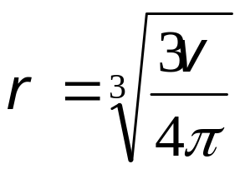
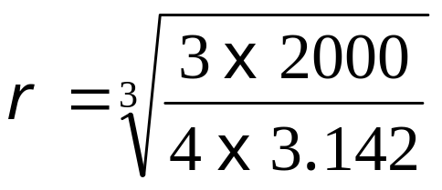

Questions 3
Questions
Substitution into Formulae
1. The formula for the surface area of a cylinder is A = 2πr(r + h) Find the surface area of the cylinder shown (in terms of π).
3cm
A = 2πr(r + h)
8cm
A = 2π x 3(3 + 8)
A = 2π x 33
A = 66π cm²
2. The radius of a sphere can be calculated from its volume using the formula below. Find the radius of the sphere shown to 2 d.p.
V = 2000 cm³

Slide 9

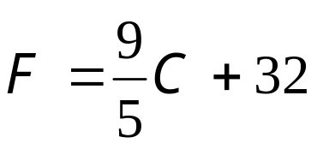
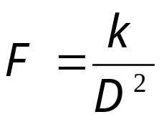

Questions
Substitution into Formulae
3. The formula shown converts temperatures given in ºC to ºF. Use the formula to convert (a) 20ºC (b) -40ºC
(a) 68ºF (b) - 40ºF
4. V² = U² + 2as is an important formula used in physics that links velocities with acceleration and distance. The velocity (V) of an accelerating object depends on its initial velocity (U), the acceleration (a) and the distance travelled (s). Find V if U = 8, a = 12 and s = 20 (1 d.p.)
V = 23.3
5. The force of attraction F, between two magnets is inversely proportional to the square of their distance apart D. Use the formula below to find the force off attraction between the two magnets shown when k = 96 and d = ½ cm.
½ cm

Slide 10
Worksheet
Questions 1
Questions 2
1. P = 4k + 3 (k = 7)
1. P = 2k² + 3 (k = 3)
2. S = 9p + 15 (p = 3)
2. S = p³ + 12 (p = 2)
3. y = 5x - 3 (x = 0)
3. y = 5x² - 3 (x = 3)
4. y = 7x - 30 (x = 2)
4. y = x² - 30 (x = 5)
5. P = -2z - 9 (z = -3)
5. P = -2z² + 9 (z = 1)
6. L = 8 - 6k (k = -2)
6. L = 4k³ + 5 (k = 5)
7. M = -6q + 2 (q = ½ )
7. M = -8q³ + 2 (q = 2 )
8. V = 8r - 7 (r = - ¼ )
8. V = 8r² - 7 (r = - ½ )

Slide 11
Questions 3
Worksheet
Substitution into Formulae
Questions
1. The formula for the surface area of a cylinder is A = 2πr(r + h) Find the surface area of the cylinder shown (in terms of π).
3cm
8cm
2. The radius of a sphere can be calculated from its volume using the formula below. Find the radius of the sphere shown to 2 d.p.
V = 2000 cm³

Slide 12
Worksheet
Substitution into Formulae
Questions
3. The formula shown converts temperatures given in ºC to ºF. Use the formula to convert (a) 20ºC (b) -40ºC
4. V² = U² + 2as is an important formula used in physics that links velocities with acceleration and distance. The velocity (V) of an accelerating object depends on its initial velocity (U), the acceleration (a) and the distance travelled (s). Find V if U = 8, a = 12 and s = 20 (1 d.p.)
5. The force of attraction F, between two magnets is inversely proportional to the square of their distance apart D. Use the formula below to find the force off attraction between the two magnets shown when k = 96 and d = ½ cm.
½ cm

